Slide 1
Know Your Hardware: CPU Memory Hierarchy
Alexander Titov

Slide 2



About me
Alexander Titov
CPU Hardware Architect
10+ years of C++ experience (CPU simulation)
Teaching Computer Architecture and Design
alexander.titov@atitov.com
alexander-titov-cpu

Slide 3
Performance Optimizations Rules
0.
Do not do it ☺
Measure it!
Do educated decisions
Do not reinvent the wheel
Optimize in the following order
General algorithm (e.g., O(NlogN) vs. O(N^2))
Memory allocation, copy vs. move, etc.
Data organization in memory and access patterns
Code footprint
Branches
…
Data organization in memory and access patterns

Slide 4
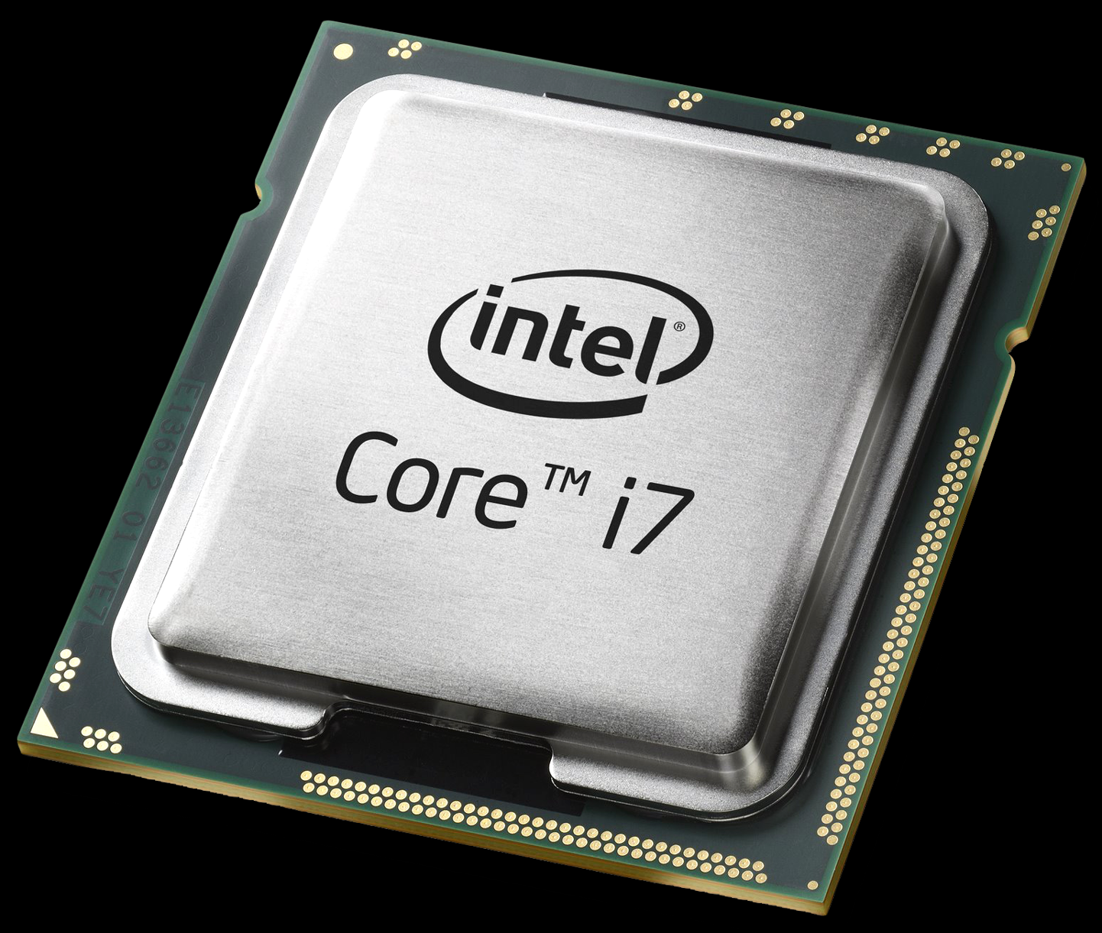
Why Is Memory So Important?
Simplified steps to execute an instruction:
Read instruction from memory
Decode it
Read inputs from memory
Execute instruction
Write result to memory
Read next instruction from memory
Decode it
Read inputs from memory
?
2
3
a[0] = b[0] + 1
a[0] =
what next?
010100…0101
CPU works a lot with Memory

Slide 5
Is Memory Fast?
Simplified steps to execute an instruction:
~0.5 ns
Read instruction from memory
Decode it
Read inputs from memory
Execute instruction
Write result to memory
CPU

Slide 6
Is Memory Fast?
Simplified steps to execute an instruction:
~0.5 ns
Read instruction from memory
Decode it
Read inputs from memory
Execute instruction
Write result to memory
CPU

Slide 7
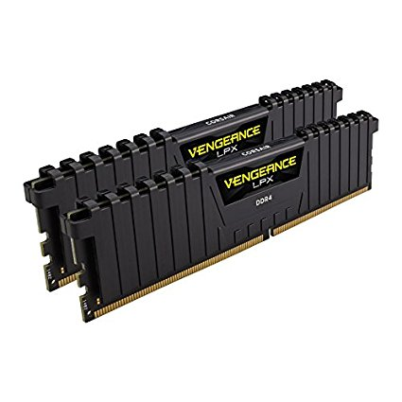
Is Memory Fast?
– No
4x
~100 ns
~0.5 ns
Memory
CPU
Memory is very slow.
CPU would wait 99% of the time for Memory response.

Slide 8
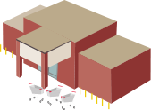


Cache Hierarchy in Real Life
3rd level
cache
2nd level
cache
1st level
cache
Factory
Warehouse
Large store
Small shop
Home

Slide 9
Cache Hierarchy
3rd level
cache
2nd level
cache
1st level
cache
Memory
CPU

Slide 10
Cache Hierarchy In Action
miss
miss
miss
Memory
CPU

Slide 11
Cache Hierarchy In Action
hit
Memory
CPU
Locality principle:
the same data is requested several times in a short period of time

Slide 12
Cache Hierarchy
10 GB – 1 TB
10 – 30 MB
256 KB – 1 MB
32 KB
3rd level
cache
2nd level
cache
1st level
cache
Memory
CPU
? GB/s
? GB/s
? GB/s
? GB/s

Slide 13
Experiment: Defining Cache Hierarchy
Benchmark structure
start
end
N times

Slide 14
Experiment: Defining Cache Hierarchy
Benchmark structure
L1 cache
L2 cache
L3 cache
Memory

Slide 15
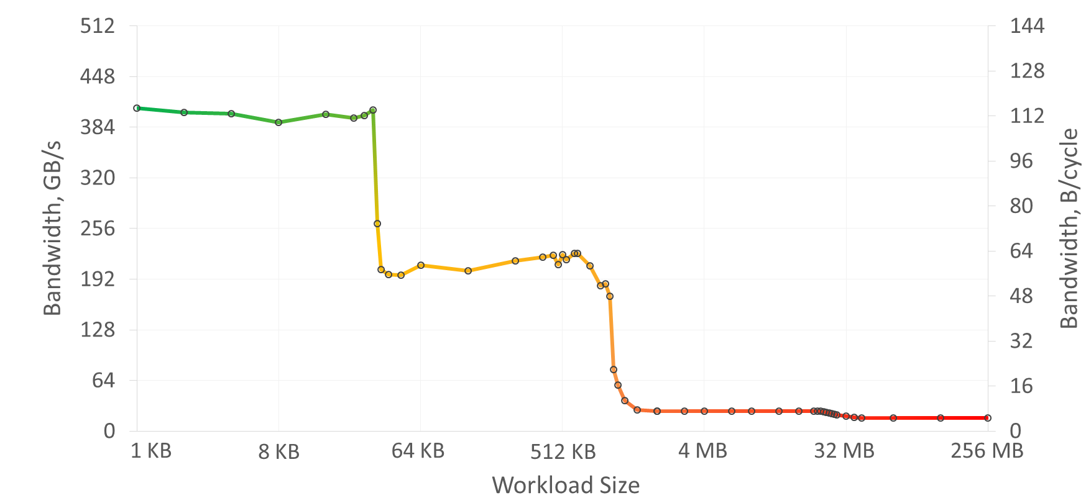
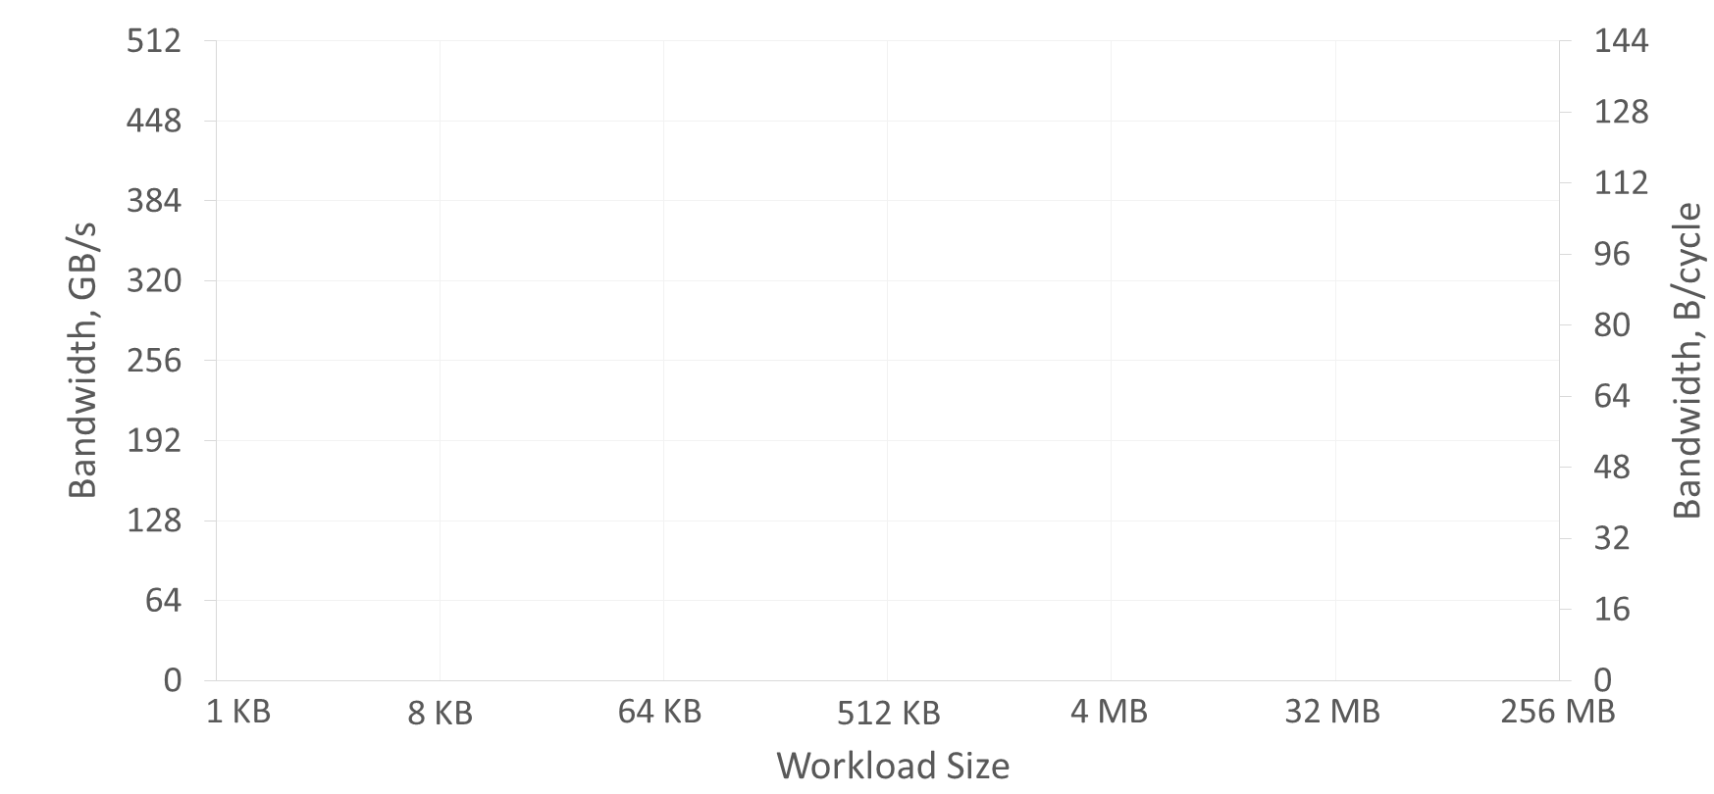
Experiment: Defining Cache Hierarchy
Intel(R) Xeon(R) Gold 6242 CPU, TDP 2.80GHz, Turbo 3.90Ghz
32 KB
1 MB
22 MB
L1 Cache
32 KB
L2 Cache
1MB
L3 Cache
22MB
Outside
Memory
intuition
400 GB/s
220 GB/s
25 GB/s
16 GB/s
25x
14x
1.5x
1x

Slide 16
Multi-Core CPU
L3
L2
L1
Memory
CPU

Slide 17
Multi-Core CPU
N times more space and BW than in a single core
L1
?
L2
Core 0
Core 0
Core 0
IL1
Core N
…
L3
Shared
L1
Core N
Memory
L2
Core N
Core N
IL1
Core N

Slide 18
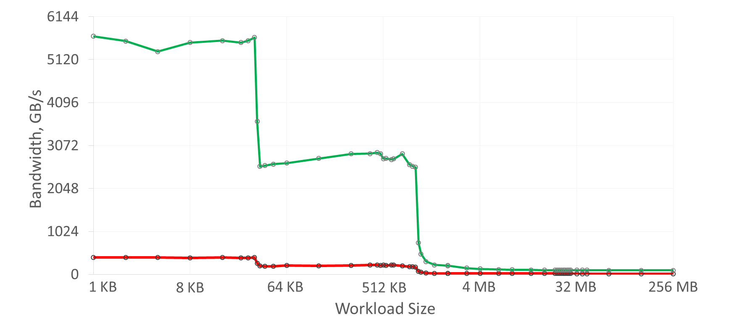
Experiment: Single-Core vs. Multi-Core
Intel(R) Xeon(R) Gold 6242 CPU, TDP 2.80GHz, Turbo 3.90Ghz, 16 Cores
single-thread
multi-thread
(16 threads; the same code,
but different memory; sum BW is shown)
~16 x
~16 x
95 GB/s vs 16 GB/s
~16 x
~6 x
Multi-threaded application receives not only N x cache space and BW,
but large Memory BW too

Slide 19
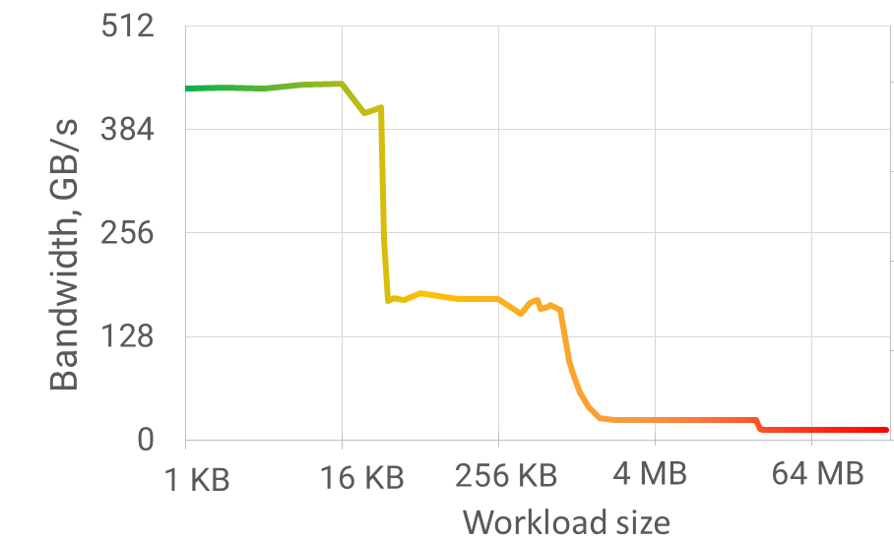
Tip: Divide and Conquer
Split large workload in parts that fit in the cache
→ improve locality
Example:
Cache
64 MB x 1000 times
→ 4096 parts x (16 KB x 1000 times)
N times
20x
speedup
N times
N times
N times
N times

Slide 20
Memory line
All data transfers are performed in aligned chunks of 64 B (memory line)
If the rest of the line is not used, it occupies space and BW in vain
Control info: address, state, protection, etc.
Memory
CPU
N * 64
(N+1) * 64
The better line utilization → the better performance

Slide 21
Tip: Split Warm and Cold Data
Extract fields that are accessed more often (warm) into a separate object
struct Mixed {
int warm;
int cold[15];
};
Mixed mixed_array[N];
struct Warm {
int warm;
};
Warm warm_array[N];
Cold cold_array[N];
struct Cold {
int cold[15];
};
0
64
128
0
64
128
6% efficiency
100% efficiency
Decrease occupied cache space and memory bandwidth by 16x times!

Slide 22

Tip: Dense Data Packing
By default, C++ has sparse data packing
Each field is aligned by its size (to prevent line splits)
#pragma pack(push)
#pragma pack(1)
struct Dense {
bool b0;
int i;
bool b1;
double d;
};
#pragma pack(pop)
struct Sparse {
bool b0;
int i;
bool b1;
double d;
};
struct LessSparse {
bool b0;
bool b1;
int i;
double d;
};
struct _Sparse {
bool b0;
uint8_t padding0[3];
int i;
bool b1;
uint8_t padding0[7];
double d;
};
// 1B
// 4B
// 1B
// 8B
24
sizeof(Sparse) ==
?
sizeof(LessSparse) ==
16
sizeof(Dense) ==
14
b0
i
b1
d
b0
b1
i
d
b0
i
b1
d

Slide 23
Pitfall: Split Atomic
Dense packing can be dangerous. E.g., lead to split line atomics.
#pragma pack(push)
#pragma pack(1)
struct alignas(64) SplitAtomic
{
uint8_t padding[63];
atomic<uint64_t> a;
};
#pragma pack(pop)
struct alignas(64) Atomic
{
uint8_t padding[63];
atomic<uint64_t> a;
};
vs.
0
64
128
0
64
128
padding
a
padding
a
atomic is in two lines
A split line atomic is ~300x slower that an usual atomic!

Slide 24
What Next?
Not discussed: virtual memory (TLB), prefetching, coherency, cache conflicts, memory types (UC, WC, etc.), cache inclusion/exclusion, memory ordering, replacement policies, false sharing, thread cross-trashing, …
Courses: MIPT, Princeton, Technion, Berkley CS152/CS61C, UW CSE378, MIT 6.004, CMU 18-447
Books: Computer Organization and Design, Computer Architecture, Modern Processor Design
Docs: Intel Architectures Optimization Reference Manual
Tools: Google Benchmark, godbolt.org / quick-bench.com, Intel VTune Amplifier

Slide 25
Many thanks!
Questions welcome :)
Alexander Titov
alexander.titov@atitov.com
alexander-titov-cpu

Slide 26
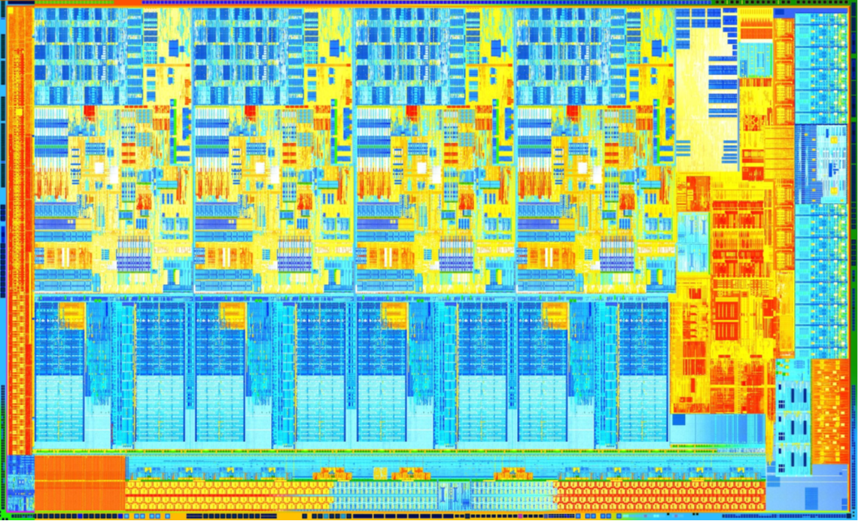
Pitfall: False Line Sharing
Do not place independent data written by multiple threads into one line!
If data is only read → OK
Example:
Core
Core
Core
Core
// each thread repeatedly writes
// only its own element
int thread_results[4];
L1
L1
L1
L1
System Agent
&
Memory Controller
want to write
snoop
0
64
L2
L2
L2
L2
snoop
snoop
Core must “own” a whole line to be able to write it
The copies in the other Cores are removed
snoop
Each write miss L1 and L2 caches!
If the data were in different lines, it would be L1 hits
Shared L3 Cache

Slide 27
Experiment: Sparse Access Pattern
What if requests are not adjacent?
64B
64B
step
128B
step
196B
step
benchmark 1
…
benchmark 2
benchmark 3

Slide 28

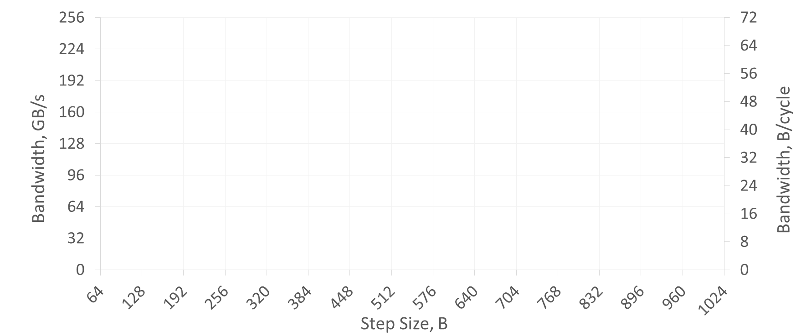
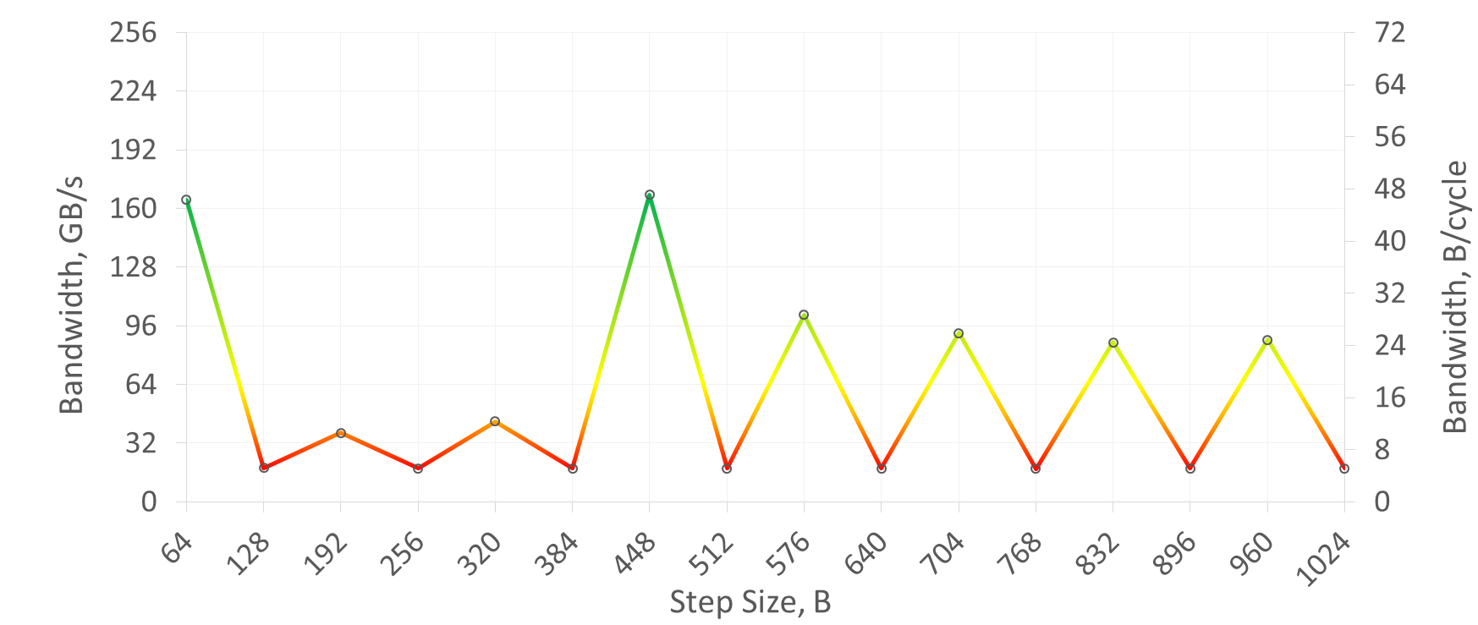

Experiment: Sparse Access Pattern
Intel(R) Xeon(R) Gold 6242 CPU, TDP 2.80GHz, Turbo 3.90Ghz
Workload size is the same for all the tests – 1 MB

Slide 29
Cache Structure
Cache block of 64B
64B
Cache
Memory

Slide 30
Cache Structure
Cache
Memory
sets
ways

Slide 31
What is going on with sparse patterns?
128B
step
Cache
Memory
sets
ways

Slide 32
Cache Hierarchy
~30 ns
~100 ns
~10 ns
~0.5 ns
~3 ns
Cache
3rd
level
Cache
2nd
level
Cache
1st level
CPU
32 KB
Outside Memory
256 KB – 1 MB
10 – 30 MB
10 GB – 1 TB

Slide 33
Cache Hierarchy in Multi-Core CPU
Cache
2nd
level
Cache
1st level
CPU
0
~100 ns
Cache
3rd
level
…
Outside Memory
Cache
2nd
level
Cache
1st level
CPU
N
10 GB – 1 TB

